Slide 1
CAPABILITY
STATEMENT
Inclusive & Sustainable Development Consulting
April 2026

Slide 2



Our Vision
Inclusive
Access + Good Governance + Agency
Ecological
Climate + Ecology + Waste
Circular
Design + Process + Behaviour
In a world of deepening inequality and fractured trust, decisions are still too often made without the people and ecosystems most affected by them.
We see inclusion as starting from everyday realities: whose needs are considered when strategies are written, when services are designed and when infrastructure is planned.
We believe that integrating diverse perspectives – across gender, ethnicity, age, disability, income and geography – uncovers a broader range of risks and opportunities, improves strategic direction and develops products and services that work in practice rather than on paper.
Inclusive planning and governance help maximise positive impacts, minimise unintended harms and build shared ownership of change.
Environmental debates have rightly focused on climate change, but a truly sustainable future also depends on the health of soils, forests, oceans and the ecosystems that sustain life - a system that is both resilient and regenerative is key.
We envision a world where we regenerate, rather than deplete natural systems – using regenerative agriculture and nature‑based solutions to better protect our rivers, coasts and urban green space.
This means understanding how decisions on energy, industry, food, buildings and transport affect ecosystems over time, not just in the next budget cycle.
As ecological thinking is embedded into economic and social choices, it underpins greater resilience, food and water security and the wellbeing of current and future generations.
Linear “take–make–waste” models are driving resource scarcity, pollution and rising costs for businesses, cities and households.
Circular economies instead keep materials and value in use for as long as possible, through better design, reuse, repair, recycling and new service‑based business models.
We focus on circularity as a practical design approach – rethinking products, processes, supply chains and behaviours so that economic activity regenerates our planet rather than depleting its resources.
With a circular economy mindset and the right tools and approach, governments, investors and companies can cut emissions and waste, create new jobs and markets, and build more resilient local and regional economies.
At UrbanEmerge, we envision a just and circular world shaped by three guiding principles that underpin all our work in inclusive and sustainable development.

Slide 3
Our Story
Cities, regions and companies worldwide face mounting pressures in an increasingly unpredictable world: deepening inequality, accelerating climate change, and a growing financing gap between ambition and action.
Municipal governments, the private sector and development finance institutions are increasingly central to solutions, yet many lack the specialist knowledge, strategy and tools to act effectively.
To help address these challenges, Andreas Beavor and Dr. Naji Makarem founded UrbanEmerge LLP in 2017, a UK-registered sustainable & inclusive urban and regional development consultancy.
UrbanEmerge was also set up to bring together a network of independent consultants under a shared brand, acting as a community and a knowledge hub, as well as a unique offer to our clients and partners. Our lean network model ensures that clients benefit from excellent value for money and a strong network of affiliated independent experts extends to countries and cities all over the world.
Today we are proud to have delivered over 80 projects across Asia, Africa, Europe and the Middle East for over 20 clients and partners. With a core team and an extensive global network of affiliated experts, we advise public and private sector clients, DFIs and development partners across four service areas:
Sustainable Cities & Regions
Circular Economies
Sustainable Business & Investment
Digital innovation for sustainability
UrbanEmerge was founded in 2017 to help cities, regions and organisations tackle social, economic and environmental challenges through practical and sustainable solutions, delivering nearly 100 projects across the public, private and civil sectors.

Slide 4

































Our Clients and Partners

Slide 5
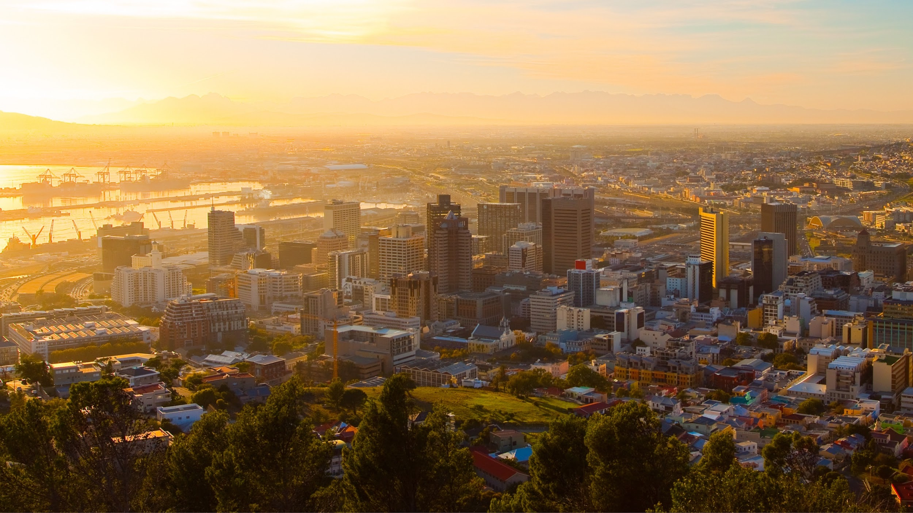
Our Service Areas
Sustainable & Inclusive Cities & Regions
Circular Economies
Sustainable Business & Investment
Digital Innovation for Sustainability
Cape Town, South Africa

Slide 6
Sustainable & Inclusive Cities & Regions
There is an increasingly urgent need for integrated and participatory strategic planning and design for cities and regions, that enables sustainable development.
UrbanEmerge has significant experience in researching and sharing knowledge on best-practice approaches, designing and implementing green cities and infrastructure programmes and advising on policy and regulatory environments and levers.
We are focused on accessible and affordable places and services in cities, including for persons with disabilities and the elderly.
We are also experts in helping clients understand and implement climate finance, to overcome barriers to project financing, including the use of public sector funds to de-risk and accelerate private sector investment.
Our Services:
Strategic land use and infrastructure planning to maximise sustainable and low-carbon development impact.
Strategies for urban and regional adaptation and resilience to climate related shocks and stresses, including nature-based solutions.
Sustainable urban systems and the circular economy.
Climate finance strategy, blended finance and project preparation services.
Inclusive & accessible urban and regional development

Slide 7



Sustainable & Inclusive Cities and Regions
Design and Implementation of the Green Cities and Infrastructure Programme (GCIEP), FCDO
Resource Pack on Delivering Inclusive Climate Action with a Focus on Inclusion of Disabled People
Support on Climate-Related Urban Infrastructure Development and Subnational and Municipal Finance
Guide for Small and Intermediary Cities on Preparing Bankable Climate Infrastructure Projects
2023 - 2026
2023
2021 - 2024
2022
GCIEP is a £70 million, multi-country programme that seeks to to catalyse investment in sustainable infrastructure, to improve the policy environment for green cities and infrastructure and to improve municipal finance and public services, creating jobs and increasing productivity and to enhance climate resilience in low and middle-income countries (LMICs). GCIEP is managed by a PwC‑led alliance including Adam Smith International, Mott MacDonald, Engineers Against Poverty and MDY Legal, and UrbanEmerge is a proud partner, contributing specialist expertise on sustainable cities, climate finance and inclusion as part of this wider consortium effort UrbanEmerge has been involved in shaping and delivering GCIEP, starting with the design of deep offer programmes in Indonesia and Vietnam, contributing research on inclusive transit-oriented development and supporting learning and communications functions. See website and LinkedIn
UrbanEmerge led an assignment to develop a resource pack to help cities deliver their commitments under C40 Accelerators in a way that is inclusive and just, with a particular focus on the C40 Clean Air Accelerator and the C40 Green and Healthy Streets Accelerator. The resource pack focuses on inclusion of people with disabilities. The work includes a research and analysis on ‘Making the Case’ for disability inclusion, as well as developing Policy Briefs for transport and mobility, energy access and disaster risk reduction, highlighting practical strategies for cities and related stakeholders, illustrated with a range of inspirational examples. With the Resource Pack, C40 will be better equipped to support cities in the delivery of inclusive climate action.
Resource Pack available here.
As part of a demand‑led support package to GIZ’s city sector project, we provided research and analysis to the German Federal Ministry for Economic Cooperation and Development (BMZ) on socially equitable, climate‑friendly and resilient urban development, particularly in rapidly growing small and medium‑sized cities. Our inputs covered adaptation finance for cities, options for project preparation and matching with climate and development finance sources, and approaches to strengthening subnational and municipal finance systems, including the role of aggregation and innovative instruments. UrbanEmerge generated analytical insights and practical recommendations on how BMZ and GIZ can better integrate climate considerations into urban programmes, enhance access to finance for city‑level infrastructure, and address cross‑cutting issues such as gender equality and social inclusion in climate‑related urban investments.
The team partnered with the CCFLA’s Project Preparation Working Group (PPAG) to co-develop guidance on barriers to climate finance presented by low creditworthiness in small and medium cities in low- and middle-income countries (LMICs), and strategies that can be implemented in the current context to overcome such barriers. The team conducted desk research and interviews to set out the barriers, the potential strategies and appropriate case studies that demonstrate valuable learning. This was followed by drafting a concise and practical guidance document to illustrate what works.
Guidance available here.

Slide 8
Circular Economies
There is an urgent need to move away from the “take, make, waste” culture of consumption as well as reducing embodied carbon.
Circular economy solutions can greatly reduce environmental impacts and greenhouse gas emissions by improving efficiencies in resources use, reducing the amount of virgin materials required for products and greatly reducing waste going to landfill.
Increasing evidence shows that there are many positive social and economic outcomes of successful circular economy approaches, such as green job creation and cost savings for public and private sector entities.
Our team is experienced in taking a holistic approach to guide clients to enable and implement circular economy transition across a range of sectors, including construction, industry, food and agriculture, water resources and solid waste management.
Our Services:
Circular economy strategy and enabling environment for cities and regions.
Research, guidance and recommendations on integrating circularity into municipal solid waste management.
Research, guidance and recommendations on plastic waste management, including programme design.
Guidance and recommendations on public-private sector collaboration for circular solutions.
Advisory services on formal and informal sector job creation through circular approaches.

Slide 9




Circular Economies
Development and application of regional compendium of applications of alternatives to single-use plastic, Pacific Island Nations
Assessment of the State of Circular Economy in Qatar
Vulnerabilities & opportunities for informal sector waste workers for social entrepreneurship & livelihoods options from plastics circularity in the Philippines
Research for GSMA on Digital Solutions for Plastic Waste Management
2024
2022 - 2023
2022
2020 - 2021
The team co‑developed a regional compendium for the Pacific Ocean Litter Project (POLP), working with the Secretariat of the Pacific Regional Environment Programme (SPREP) to document and assess practical alternatives to single‑use plastics across the Pacific Island countries and territories of Fiji, Samoa, Vanuatu and Tonga. Drawing on detailed product and material analysis, stakeholder engagement and review of artisan and commercial initiatives, we identified viable biodegradable and reusable substitutes for key single‑use items, assessed supply‑chain and cost implications, and highlighted opportunities and barriers to scaling. This provided SPREP and national governments with evidence‑based guidance to support policy reform, green enterprise development and regional collaboration on reducing plastic pollution.
The Global Green Growth Institute (GGGI) works closely with the Government of Qatar and commissioned UrbanEmerge to conduct a comprehensive assessment of the state of play of circular economy in the country, across all sectors including construction, tourism, hostility, food and agriculture, industry and solid waste management. UrbanEmerge worked alongside Net Positive Labs and Qatar University to review the challenges and opportunities for circular economy approaches across these sectors, with the aim of helping achieve economic diversification, climate action, pollution prevention, and resource efficiency in Qatar. The study helped to lay the foundations for integrating the principles of circularity and sustainable consumptions and production into national development planning and implementation processes.
UrbanEmerge conducted research for the World Bank to investigate the vulnerabilities that impact informal waste sector workers, with a particular focus on the specific challenges faced by women and children. The team’s objectives are to identify, map, and assess livelihood models that exist in the informal sector and evaluate initiatives that can achieve a “closed loop” recycling system or circularity, particularly in relation to plastic waste. A comprehensive literature review was complemented by in-depth field research at four waste management sites in the Metro Manila area. Circular business models that integrate informal sector workers were explored and recommendations provided for policymakers in the Philippines.
UrbanEmerge conducted research for the GSMA Mobile for Development CleanTech team on digital innovation that can improve plastic waste management in LMICs. A global overview of relevant organisations and solutions was carried out followed by deep-dive research in seven countries in Africa and Asia to gain a detailed understanding of plastic waste value chains and the opportunities and constraints, as well as issues related to inclusion and e-literacy. The research is also designed to understand how MNOs can support more effective plastic waste collection, through initiatives such as providing airtime credit in exchange for plastic waste materials. Report Link

Slide 10
Sustainable Business & Investment
We also support businesses who wish to increase their positive environmental and social impact; we provide the insights, approaches and tools to help make it a reality.
Private sector companies have an important role to play in their investment decisions and business operations now, to help reduce environmental degradation, improve human development and reduce the catastrophic impacts of climate change over the coming decades and beyond.
Being a responsible business does not have to come at an additional cost. It is possible to integrate sustainability into business with knowledge and planning. In addition, customers and clients are starting to normalise responsible business activities and circular economy solutions can lead to efficiencies and cost savings.
Our Services:
Guidance and strategy on meaningful sustainability, climate action and resilience across business operations
Circular economy innovation and business models for the private sector.
Advisory services on impact investing.
Feasibility studies for inclusive and sustainable infrastructure projects
Designing and delivering tailored training, capacity‑building and coaching programmes on topics such as sustainable urban investment, climate finance and circular economy

Slide 11



Sustainable Business & Investment
Evidence Review of Market-Based Approaches in Climate Finance
Frontier Paper on Circular Economies
Scaling Innovation and Supporting Entrepreneurship Ecosystem across the Indo-Pacific
Developing Guidance for CSOs to Operationalise Environmental Sustainability, Mannion Daniels
2023
2021
2022
2021
UrbanEmerge supported GCF by carrying out a synthetic review of market-based approaches to mitigation and adaptation with a focus on payments for environmental services (PES), willingness-to-pay assessments, insurance products and results-based payment (RBP) modalities. We focusing on analysis of existing systematic reviews from both the peer-reviewed and grey literature, to highlight commonalities across the selected market-based approaches to inform learning within the Green Climate Fund. The Synthetic Review includes an in-depth analysis of the findings and approaches taken, including a critical appraisal of the methods used to establish the evidence base
British International Investment (formerly CDC Group) commissioned UrbanEmerge to assess circular economy approaches in Africa and South Asia to inform its updated Code for Responsible Investing and a new five‑year investment strategy. UrbanEmerge analysed key concepts, trends and risks, and highlighted how circular models can decouple resource use from growth, cut emissions and pollution, and support more inclusive, resilient business models across priority sectors such as infrastructure, manufacturing, food and agriculture, construction and healthcare. The work identified approaches to decouple resource use from economic growth, reduce GHG emissions and pollution, and support more resilient, inclusive business models in lLMICs.
Working with The Hungry Lab, UrbanEmerge supported a group of entrepreneurs in the Indo-Pacific to improve their business model and technology utilisation with a view to making them more impactful and more sustainable. We supported nine entrepreneurs to scale the sustainability component: Integrating sustainable approaches into commercial models; defining opportunities for sustainable social and environmental impact; exploring Web 3.0 applications such as blockchain to support verification in the voluntary carbon market and offering comprehensive business services advice from technology and software, commercial and legal aspects, digital identity and data security. Start-ups included ATEC clean cooking in Cambodia, TraSeable in Fiji and Greenovator in Myanmar.
Mannion Daniels, who manage the UK Aid Direct platform, were looking to develop a comprehensive and practical resources for operationalising environmental sustainability for civil society operations (CSOs) implementing UK Aid programmes. We provided guidance, supporting tools and templates for setting up an Environmental Management System (EMS), conducting an assessment of environmental impact and mitigating actions, conducting a carbon footprint assessment, with consideration for multiple different country contexts, guidance on net-zero and the role of carbon offsetting (as a last resort).

Slide 12
Digital Innovation for Sustainability
Digital technologies are reshaping how cities, governments, companies and communities respond to climate change, manage natural resources and deliver essential services, yet many promising ideas still stall at pilot stage or fail to reach the people and places that need them most.
Organisations often struggle to navigate fast‑moving technology landscapes, fragmented data, gaps in connectivity and skills, and concerns around governance, equity, privacy and bias – especially in low‑ and middle‑income settings where climate risks and digital divides are most acute.
UrbanEmerge helps clients cut through this complexity and focus on where digital and AI‑enabled solutions can genuinely unlock inclusive, low‑carbon and resilient development. We work with them to identify high‑impact use cases, design viable business and delivery models, connect innovations to climate and development finance, and ensure that solutions are accessible and accountable for users who are typically left behind.
Our Services:
Research and advisory services on digital and mobile-enabled solutions that enable sustainable development.
Advisory services on how digital solutions and new technologies can enable inclusion and empowerment.
Linkages between emerging digital technologies and climate finance.
Data-driven and AI-based solutions for sustainable cities and infrastructure
Stakeholder partnerships that unleash data for sustainability.
Notes:
Lift away from line

Slide 13


Digital Innovation for Sustainability
EU digital innovation for climate resilience in Central Asia – EU‑funded programme
UrbanEmerge contributed to an EU‑funded initiative on climate resilience in Central Asia by analysing how digital and data‑driven solutions can support adaptation and risk management in data‑sparse, hazard‑prone environments. The work focused on applications of Earth observation, remote sensing and climate–spatial data (including satellite‑based hydrology, crop and runoff monitoring, digital twins and early warning systems) for floods, landslides, droughts and water‑energy‑agriculture nexus management, and set out options for interoperable data platforms and AI‑enabled analytics tailored to regional capacity. UrbanEmerge translated these insights into practical recommendations on priority use cases, enabling policies, investment needs and regional cooperation mechanisms for EU institutions and Central Asian partners, helping them move from fragmented pilots to scalable digital climate‑resilience architectures.
Making Climate Finance Work for Early-Stage Innovations in Low Income Country Settings
Mobile and Digital Solutions for Early Warning Systems in the Philippines
The Philippines is among the countries at greatest risk from climate-related hazards and as these are increasing in intensity and frequency, enhancing early warning systems has never been more crucial. Within this context we conducted research for GSMA on The Role of Digital Technologies in Strengthening Early Warning Systems (EWS) for Disaster Preparedness in the Philippines. Our team of experts in disaster resilience and digital solutions for sustainability conducted interviews with relevant stakeholders in the Philippines to understand current EWS systems and gaps and opportunities for enhancement by digital and mobile-enabled solutions. We also explored and applied learning from other examples of digital and mobile solutions for inclusive and effective EWS across Southeast Asia. Report available here.
Digital inclusion and assistive technologies – GSMA Assistive Tech
2023
2023
2021 - 2022
2021
UrbanEmerge conducted a landscape study for the Frontier Tech (FT) Hub, funded by the FCDO, which is part of FCDO’s broader ‘Ideas to Impact’ portfolio. This is to provide a series of insights on how the shortlisted pilots can best position their innovations for future funding, including benefiting from public sector climate finance to help enable and de-risk private sector investment. The study focused on pilots in the agriculture and forestry sectors. Such pilots include FT Hub’s early warning forest fire detection system in Pakistan, electrifying water transport for better livelihoods in Senegal, and safeguarding land-based climate investments in Ghana with blockchain. This resulted in a public report available here.
The team supported the GSMA Assistive Tech and wider digital inclusion agenda through research on how mobile and smartphone‑based assistive technologies can close the “mobile disability gap” in low‑ and middle‑income countries. Building on GSMA analyses of handset accessibility features, assistive apps, mobile internet usage and innovation funding, we examined the technical and policy ecosystem for inclusive solutions (ranging from screen readers and captioning to accessible UX, AI‑enabled services and mobile‑based AT platforms), and the roles of operators, start‑ups and social enterprises. The evidence and case studies were key in providing guidance on device and service accessibility, data‑driven targeting of users with disabilities and safe‑by‑design digital inclusion, informing GSMA’s advocacy, guidelines and innovation fund support for scalable, inclusive assistive tech.

Slide 14

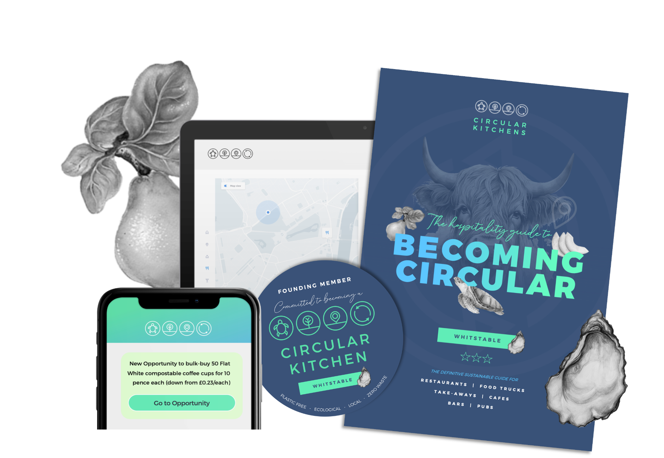
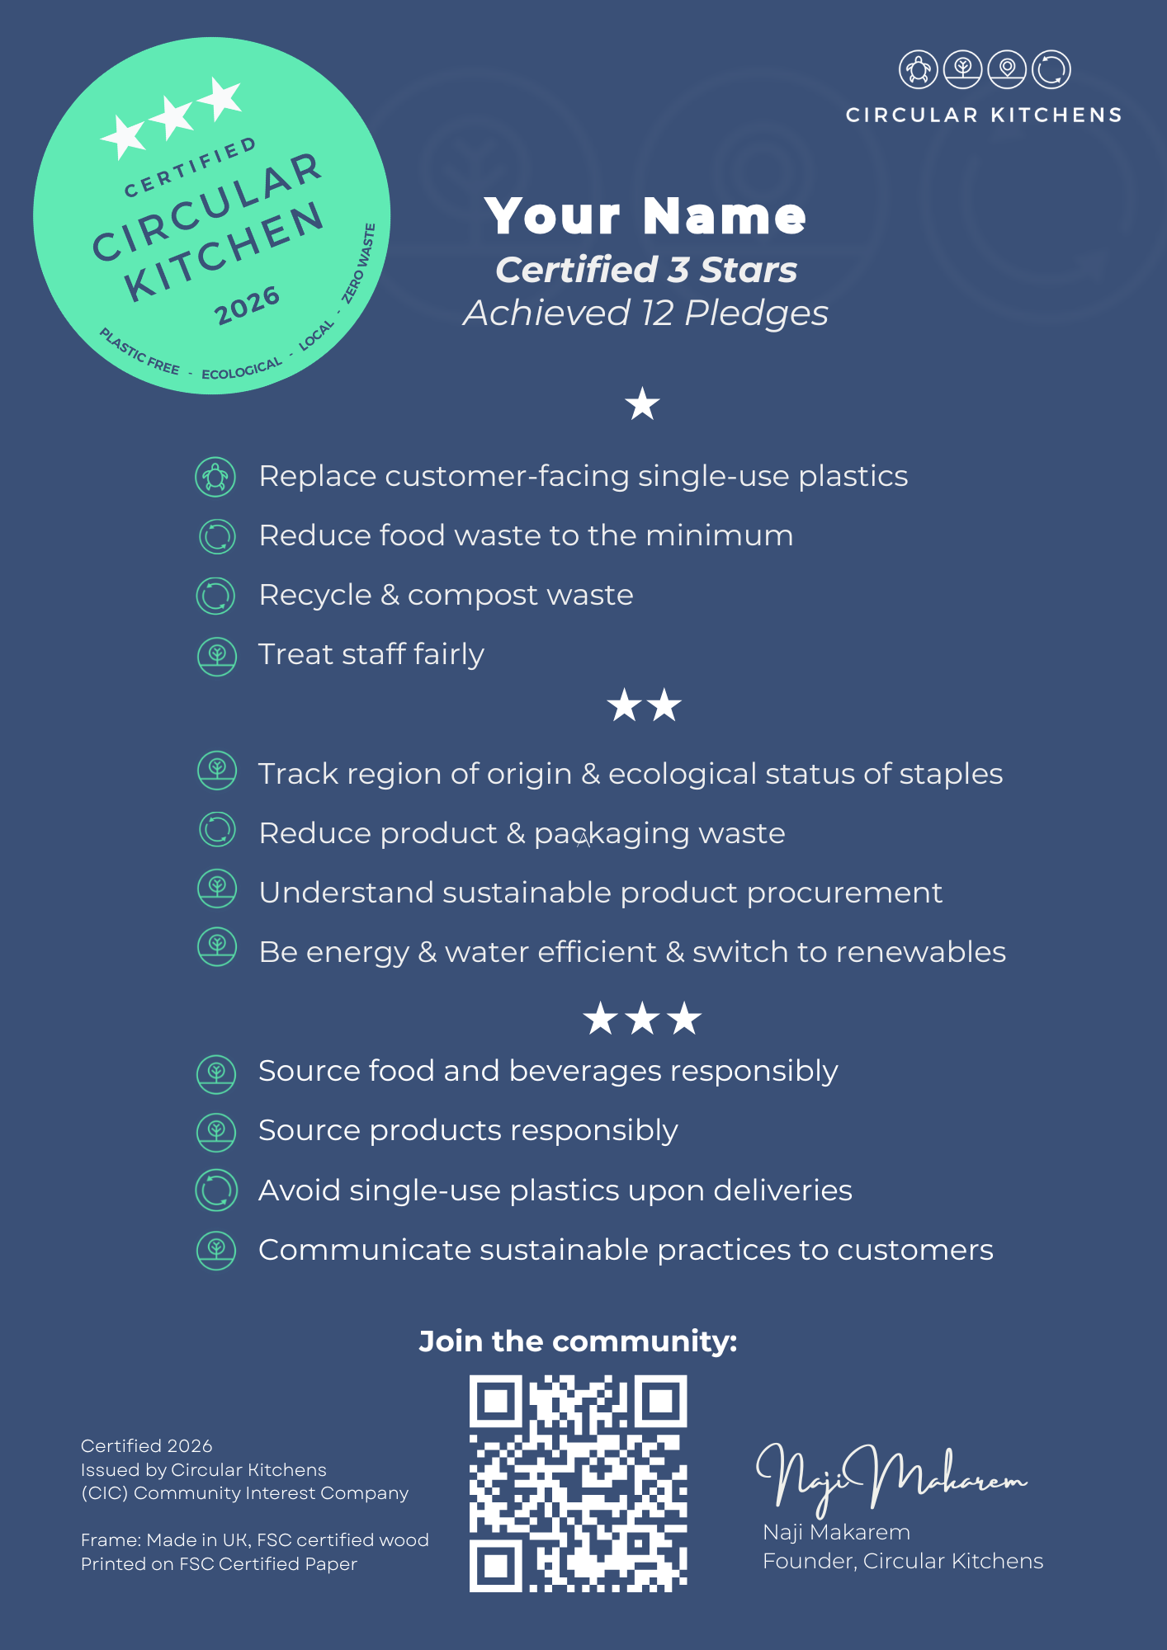
Circular Kitchens
Join the Community:
Beyond our consulting work, UrbanEmerge also develops innovative and practical solutions that target binding constraints to a just and circular transition.
Tools: UrbanEmerge has developed tools that target vital points for a circular transition in hospitality:
Sustainable Products database (Scored and ranked)
Local Food & Beverage Suppliers database
On-demand Market Research (UrbanEmerge Research)
Our first innovation project is a social enterprise called Circular Kitchens (CIC), which we seeks to transform food system based on four key principles: 1) plastic free, 2) ecological, 3) local and 4) zero waste.
Launched in 2024 in Whitstable, Circular Kitchens has worked with 10 Founding Members to co‑create a framework and certification system based on 12 Pledges and a progressive 1–3 Star rating.
Led by UrbanEmerge co-founder and Managing Partner, Dr. Naji Makarem, the team has developed a step‑by‑step journey based on tailored support and regular consultations so that progress is credible, measurable and workable in real kitchens.
We work with restaurants, cafés, pubs, bakeries, caterers and other food businesses to drive meaningful change and build a growing network of circular kitchens that strengthen local food systems, reduce food and material waste, support regenerative producers and demonstrate that hospitality can lead the transition to a more sustainable food future.

Slide 15
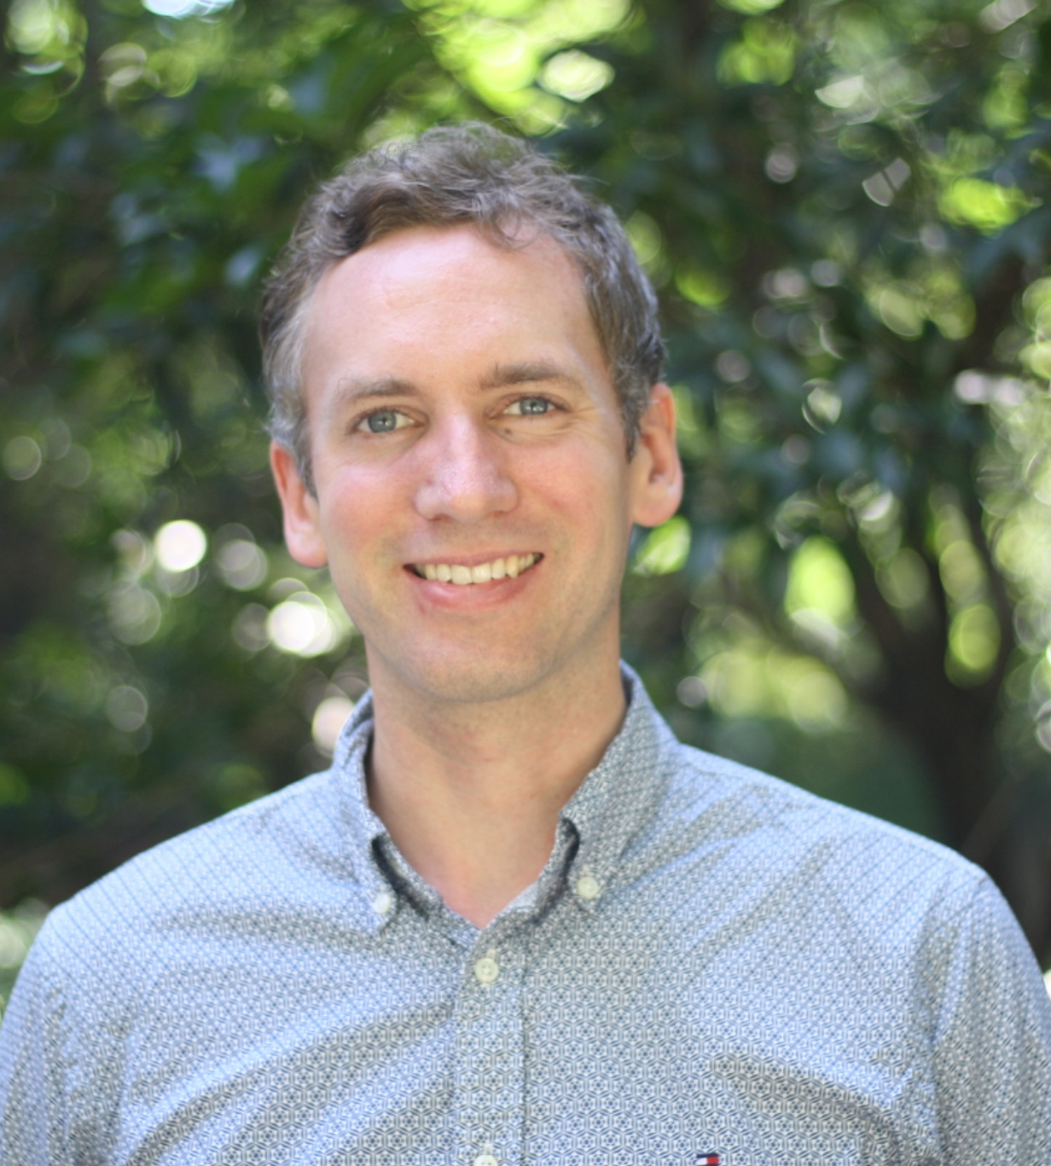
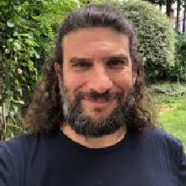
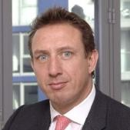
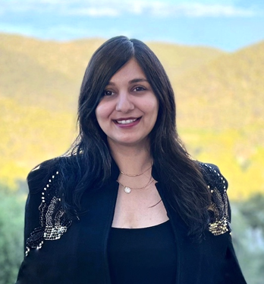
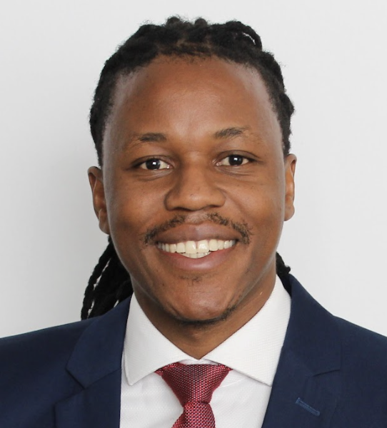
The Core Team
Andreas Beavor, Managing Partner is a climate finance and sustainable cities specialist with 18 years’ experience designing, implementing and evaluating complex programmes across Africa, Asia, the Middle East and Europe. He focuses on low‑carbon and resilient urban infrastructure, innovative climate and nature finance, nature‑based solutions, circular economy approaches and digital solutions for climate action. Andreas has led major assignments for clients including FCDO, GIZ, DESNZ, the Green Climate Fund, C40 Cities, GSMA, the World Bank and regional development banks, and is highly experienced in evaluation, learning and communication of programme results. He holds an MSc in International Relations from the University of Bristol and a BA in Geography with European Studies from the University of Exeter.
Naji Makarem, Managing Partner an economic geographer and sustainable urban development strategist with over 25 years of experience, including 13 years advising international organisations, governments and businesses on circular economies, industrial and circular development strategies and sustainable urban transitions. As an Associate Professor at UCL Naji combines academic research with hands‑on consulting to design strategies, frameworks and tools for inclusive, ecological and resilient regional development. He is the founder of UrbanEmerge spin-off, Circular Kitchens. Naji holds a PhD in Urban Planning from UCLA, an MSc in Local Economic Development from the LSE and an MBA from IESE Business School.
Fizza Fatima, Sustainability Consultant is an architect and climate finance specialist with nearly 10 years’ experience across low-carbon infrastructure, resilient urban development and green finance. She has delivered climate and carbon finance strategies, municipal climate finance and gender-responsive urban funding for clients including the Green Climate Fund, FCDO, C40 Cities, GIZ, UN-Habitat, UNIDO and the GSMA Foundation. She holds MSc degrees in International Cooperation in Urban Development (TU Darmstadt) and Sustainable Emergency Architecture (UIC Barcelona), and a Bachelor of Architecture from NED University, Pakistan.
Jonathan Wilkes, Financial Director is a seasoned finance professional with around 20 years of CFO experience with SMEs in the UK, bringing deep expertise in financial strategy, capital raising and business planning. An Economics graduate from the University of Bristol and Chartered Accountant trained at PwC in London, he now works as a portfolio “flexi‑CFO” supporting owner‑managed businesses to structure their finances, optimise performance and secure growth funding. Jonathan leads UrbanEmerge’s financial management and advises on commercial modelling and risk for complex programmes and social enterprises.
Mpho Katjiuongua, Sustainability Consultant is a climate finance and public policy specialist with 8 years experience across Africa and global programmes, focusing on adaptation finance, inequality and green investment. He has supported governments, cities and financial institutions to design and finance climate‑resilient investments, including work on national climate strategies and NAPs in Namibia, private‑sector adaptation finance, and climate justice‑oriented disclosure and policy reforms. At UrbanEmerge he contributes to climate finance research and training for cities, digital agriculture and climate‑data studies, blue economy innovation, and learning work for FCDO’s Green Cities and Infrastructure Programme (GCIEP). Mpho holds an MSc in Sustainable Finance and Fintech from SKEMA Business School and is a Certified ESG Analyst (CESGA).

Slide 16


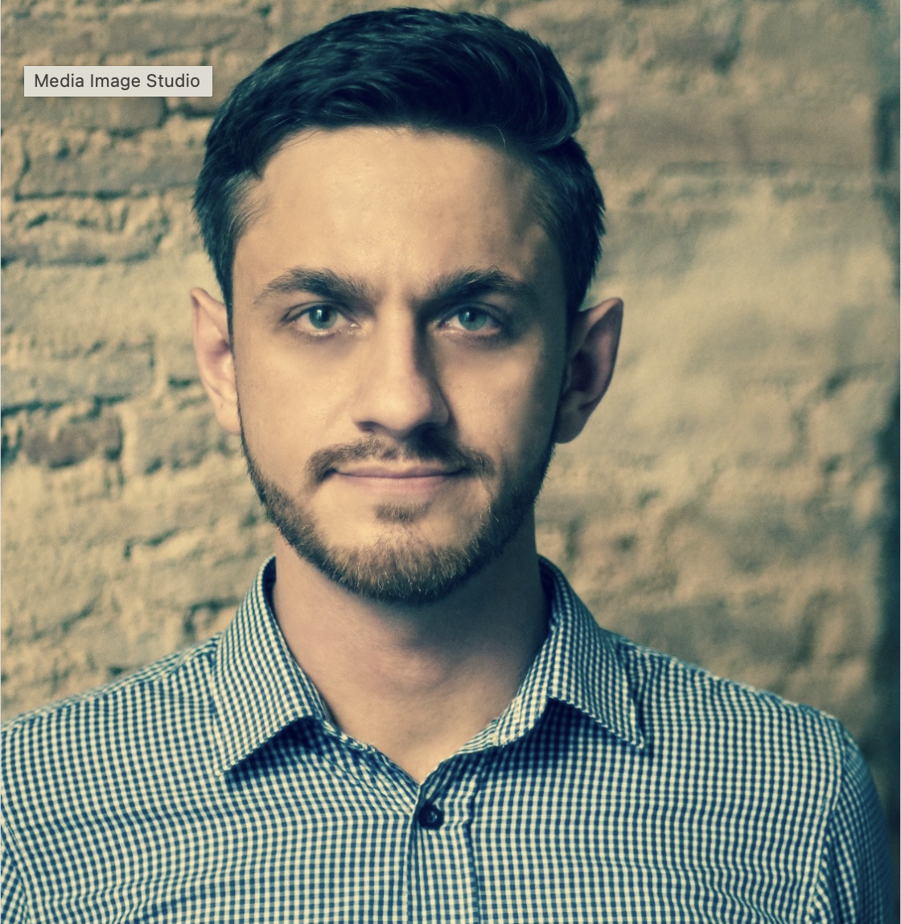
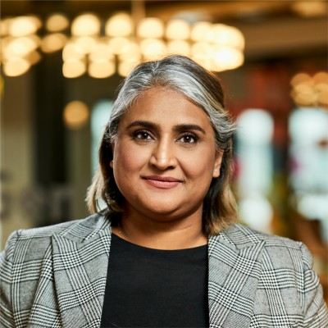

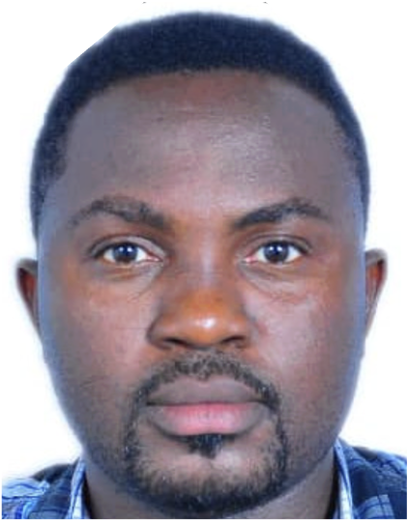

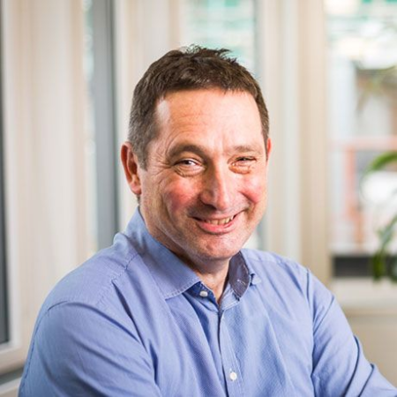
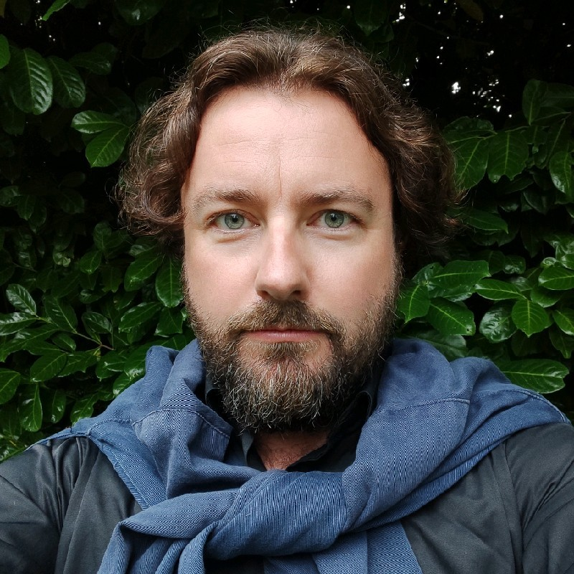



Consultants in our Community
We have over 80 trusted consultants in the UrbanEmerge community with a range of expertise ranging from: ESG advisory and climate finance, solid waste management and circularity economy solutions and development economics to inclusive infrastructure development, technology solutions (incl. edge AI, IoT and mobile‑enabled tech) and digital inclusion and fintech. Here is a snapshot of our wider group of experts:
Veronica di Bella
Environmental, Social and Waste Management Specialist
John Ward
Development economics and
climate finance
Joshua Palferman
Solid waste management and circular economy
Asma Jhina
Climate Finance and Inclusive Cities Expert
Benneth Obinna Obasiohia
Waste Management and Recycling Specialist
Dream Meng Liu
Digital Inclusion, Entrepreneurship and Fintech Specialist
Robin Bloch
Sustainable Urban and Regional Planning
Bian Li
Regenerative Futurist and Emerging Technologies Specialist
Andrew Parker
Economist, Sustainable Regional Development, Trade, Agribusiness & marine sectors
Steve Lorimer
Regenerative Infrastructure & Spatial AI Specialist
Laura Jungman
Climate finance and Nature-based Solutions for Urban Resilience
Vidya Naidu
Inclusive Cities and Infrastructure, GEDSI and Safeguarding

Slide 17


Andreas Beavor
Managing Partner
andreas.beavor@urbanemerge.com
Inclusive & Sustainable Development Consulting
Naji Makarem
Managing Partner
To know more about our work please visit www.urbanemerge.com
naji.makarem@urbanemerge.com

